Slide 1

Software Process
Abram Hindle Henry Tang
hindle1 @ualberta.ca hktang@ualberta.ca
Department of Computing Science
University of Alberta
CMPUT 301 – Introduction to Software Engineering
Slides adapted from Dr. Hazel Campbell, Dr. Ken Wong, and Dr. Abram Hindle
Images reproduced in these slides have been included under section 29 of the Copyright Act, as fair dealing for research, private study, criticism, or review. Further distribution or uses may infringe copyright.

Slide 2
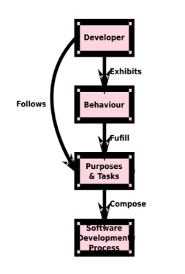
What Makes a Process?

Slide 3
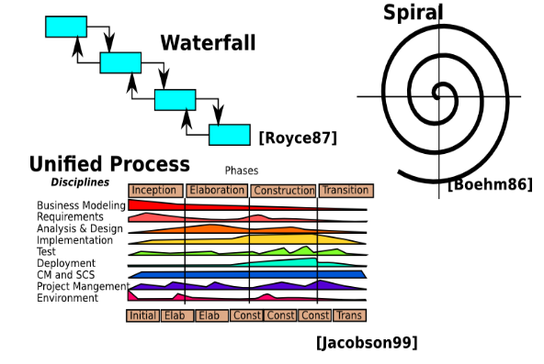
Software Development Processes

Slide 4
Developer Perspective
Software engineering:
Manage complexity, scale, lifetime
Increase quality
Reduce defects
Reduce maintenance and support costs
Reduce time-to-market
Reuse successful solutions
Apply methods and tools
Iterate and optimize
Notes:
gather measures (defect rates) and instill practices to improve (code inspection)

Slide 5
User Perspective
Software usability:
Meets needs
Increase productivity
Easy to learn
Effective to use
Reduce errors
Safe to use
Notes:
more about users later

Slide 6
User Perspective
Experience:
Satisfying
Motivating
Looks nice
Enjoyable
Fun

Slide 7
Meeting Needs
Verification
Making sure you develop the system right (i.e., according to the requirements)
Notes:
not hacked together
given requirements (user out of the loop)
verification
testing

Slide 8
Discussion
What are some major activities in developing software?
Is there an effective order on these activities?
Notes:
some developer activities
requirements specification (what the system should do, and how well)
architectural design (high-level components and dependencies)
detailed design (data structures and algorithms)
coding
testing
delivery
maintenance
natural way might be to do them in order
waterfall
code first, ask questions later?
these activities can be structured or enacted in various ways, called process models
sequence
notations
tool support

Slide 9
Waterfall

Slide 10
Waterfall Lifecycle Model
Requirements
Specification
Architectural Design
Detailed Design
Coding and Unit Testing
Integration and Testing
Delivery and Operation
Maintenance and Support
Notes:
classical SE method, no real surprises
Winston Royce 1970, idea not the term, did not advocate this but prototyping
shown are phases or activities
documents produced at each phase
each phase begins after the previous phase is completed
linear, there is no going back
alternative has feedback edges
case when you do not need maintenance?
ICBM example

Slide 11
Discussion
What are some pros and cons of the waterfall model?

Slide 12
Waterfall
Pros:
Easily understood
Enforces discipline
Verification at every phase
Well-documented product
Notes:
all models are wrong, but some are useful
signing off
which government
military software needs documentation

Slide 13
Waterfall
Cons:
Uses a manufacturing view of software
Most software is not made as a “final” product
Customer must be patient
But time-to-market is critical
Customer sees the system only at the end
May not satisfy their real needs
No early feedback
In-house testing does not involve the user until near the end
Notes:
some users seem to think that way
that is, once it is written, it should work forever
how to involve the customer?
marshmallow tower challenge
20 strands of dry spaghetti
tape
1 marshmallow

Slide 14
Waterfall
Cons:
Dependence on requirements being “right” at the start
This is almost never the case
Could end up building the wrong system
Requirements must all be known up front
But cannot always foresee all the necessary and changing requirements
Summary
Need to be able to iterate – waterfall is not effective
Notes:
not the way most software is developed, but it is still something to aim for (in part)
documenting the system as if we followed waterfall
Parnas and Clements (1985)—A Rational Design Process: How and Why to Fake It
even if you don’t do it this way, you fake it
like scientific method
like mathematical proof
some still contend a waterfall model
has anyone had a project that was a pure waterfall?
- outsourced contract

Slide 15
Prototyping

Slide 16
Meeting Needs
Validation
Making sure you develop the right system (i.e., what the customer really needed)
Notes:
validation
user involvement and feedback
user doesn’t always know what he or she wants

Slide 17
Prototyping
Iterative design:
Cycling through several designs
Improving the product with each pass
Various approaches (in combination):
Throwaway
Incremental
Evolutionary
Notes:
passes
conceptual prototype
initial working prototype
improved working prototype
like spiral process model
determine goals
identify risks
development and test
plan next iteration

Slide 18
Throwaway Prototyping
Process:
Heavily involve real users
Build and test prototype
Gain knowledge for the real product
What is necessary
What works
What does not work
“Throw away” the prototype, then “develop” the product for real
Notes:
preliminary experiment (shown to user) before developing the real product
collect requirements
collect design ideas
technologies used in the prototype might be different from final implementation
“develop” uses some other software process
“Plan to throw one away; you will anyhow.”
— Fred Brooks, famous software engineer
backtracked
real product may still not be right

Slide 19
Throwaway Prototyping
Pros:
More communication between users and developers
Functionality is introduced earlier, which is good for morale
Notes:
showing mockups or wireframes to target audience, before spending lots of effort

Slide 20
Throwaway Prototyping
Cons:
Building the prototype must be rapid
Some qualities may be sacrificed, like security, reliability, etc.
Temptation to use the throwaway prototype in the final product
Notes:
users see the system apparently working, but may not understand the delay until they can really use it
cutting corners, then maintaining it, bad idea

Slide 21
Incremental Prototyping
Process:
Triage system into separate “increments”
I.e., “must do”, “should do”, “could do”
Develop and add one increment at a time
Example: Accounting system
Prototype 1 – general ledger
Prototype 2 – accounts receivable/payable
Prototype 3 – payroll
Notes:
increments or components or features
must
you have to do it
should
you don’t have to do it
could
you want to do it
lay down a foundation
general ledger
accounts with transactions (debits and credits)
accounts receivable
issue invoices
accounts payable
issue cheques
payroll
- people being paid

Slide 22
Evolutionary Prototyping
Process:
Feature is refined or “evolved” over time
Example: Text editor
Prototype 1 – keyboard Cut and Paste
Prototype 2 – touchscreen Cut and Paste
Prototype 3 – Cut and Paste works with Undo
Notes:
building a shack first, then refine with better roof, windows

Slide 23
Other Kinds of Prototypes
User interface sketches
Hand-drawn or using drawing tool
Storyboards
Graphical depiction of user interface
Like a comic strip, but only draw the UI
Notes:
low fidelity prototypes
possibly “pixel perfect”

Slide 24
Other Kinds of Prototypes
Index cards, Post-It® notes
E.g., tasks in a project plan
E.g., classes in an object-oriented analysis
E.g., pages in a web site structure
Notes:
thinking at a higher level
easy to make changes, rearrange, cluster, and connect
no need to erase
planning and status wall using post-it notes
working things out on napkins in bars

Slide 25
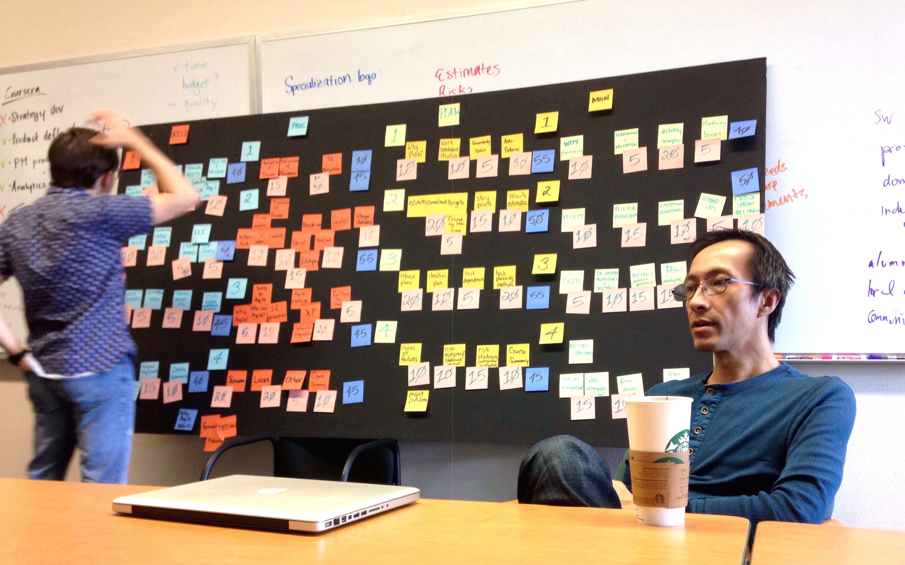

Slide 26

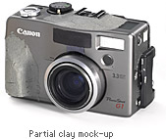

Other Kinds of Prototypes
Physical mockups:
E.g., made from wood, clay, or foam
© Canon
Notes:
clay to sculpture the right curves at the hand grip
clay prototype for a car, to better visualize it in 3D
3D printing
mouse design
testing of phones

Slide 27

© Alan Kay
Notes:
Alan Kay (1968)—Dynabook
father of personal/mobile computing
believing that anyone could use a computer, on-the-go, maybe at the beach
computing is for the masses
graphical user interfaces not command lines
enable people to learning, think, create
wheels for the mind
made out of card board
now, we can achieve such great things like:
cat videos
selfies
unlimited napping
glorified TVs

Slide 28
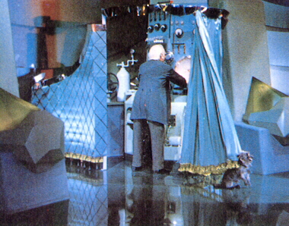
Other Kinds of Prototypes
Wizard of Oz:
“Pay no attention to that man behind the curtain!”
Feature is “implemented” through human intervention “behind the scenes”
© MGM
Notes:
canned data

Slide 29
Staged Delivery

Slide 30
Staged Delivery
Developers:
Deliver the system in a series of working releases or builds
Users:
Use some functionality while the rest continues to be developed
Possible parallelism:
Production and development systems
Staggered development streams
Notes:
to gain feedback
developing prototypes
loops, not one linear pass
initially conceptual, later working
some involving new features
some involving refined features
process followed in course project
some released to user for feedback
time scale of a prototype? year? month? week? day?

Slide 31
Staggered Builds
deliver build i
Analysis
Design
Code
Test
deliver build i+1
Analysis
Design
Code
Test
deliver build i+2
Analysis
Design
Code
Test
t
Notes:
could have some iteration within each build

Slide 32
Staged Delivery
Pros:
Provides more options
Different builds focus on specific features
Reduces estimation errors
Risks are reduced earlier
Notes:
options like not releasing the build
provides continuous revenue

Slide 33
Staged Delivery
Cons:
Overhead needed to plan and drive the product toward staged releases
Extra complexity of supporting multiple versions in the field

Slide 34
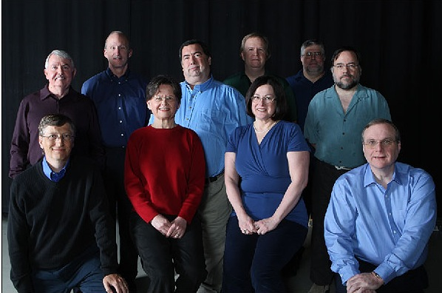
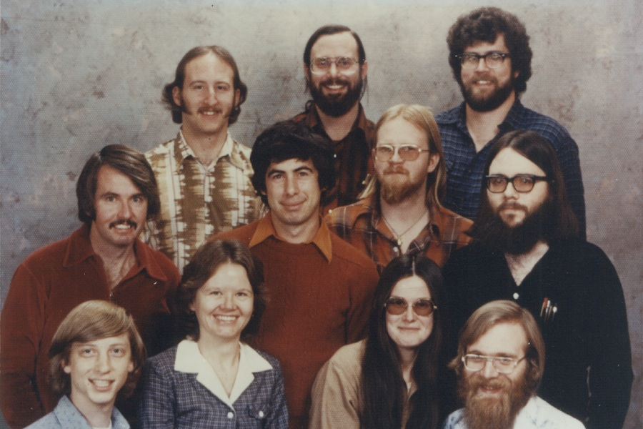
© Microsoft
Notes:
Microsoft team 1978
Bill Gates about 22 or 23 at the time
70’s show

Slide 35
Microsoft Daily Build
Process:
Software product is built every day
Build cycle becomes the heartbeat of the project; everyone knows the status
Built system must be runnable for overnight testing
Notes:
not every product
time
11:00 – 14:00 – check in
14:00 – 17:00 – build
18:00 – 09:00 – test
source code management or version control system
in team projects, typically have a system to store the source code
check out version for editing in your own sandbox to play with
check in changes
burnable to a CD to release

Slide 36
Microsoft Daily Build
Testing:
If the build breaks (not runnable nor testable), the whole process is stopped until the problem is found
Failures detected during testing are available and broadcast next morning
Huge incentive not to break the build
Notes:
whoever breaks the build will have to supervise the build and overnight testing (no going home)
contentious back then
perhaps discourages major changes

Slide 37
Unified Process

Slide 38
Agile Practices
Notes:
planning and detailed upfront requirements
still needed for subcontracted development
but not always necessary for other applications
in reality, requirements change
agile
adapting to change
some planning, but not heavyweight all up-front
some people don’t like plans, because it reveals how late they are
here, adaptive planning

Slide 39
“Agile Manifesto”
A short set of values for building software in a flexible, iterative way
http://agilemanifesto.org/
Notes:
not entirely no process, no documentation, no plan
principles that benefit both developers and users

Slide 40
Agile Principles
Individuals and interactions over processes and tools
Working software over comprehensive documentation
Customer collaboration over contract negotiation
Responding to change over following a fixed plan

Slide 41
Agile Principles
Individuals and interactions:
Trust motivated individuals
Face-to-face conversation
Best work emerges from self-organizing teams
Team reflects on and adjusts their behavior
Promote constant, sustainable pace

Slide 42
Agile Principles
Working software:
The main measure of progress
Continuous, frequent delivery of value
Notes:
value
- tangible to user, not just documentation or software library

Slide 43
Agile Principles
Customer collaboration:
Customers and developers work together
Satisfy customer early
Notes:
engaging the customer
involve them during the development
manages expectations
set priorities, focusing on the 20% of needs that produce 80% of the benefits
satisfy early
early working prototype
not bottom up development, with late integration
integrate early
may need to go slow to go faster later, rather than delaying integration to keep people busy

Slide 44
Agile Principles
Responding to change:
Welcome changing requirements, even if late
Technical excellence and good design
Simplicity – art of maximizing work not done
Notes:
simplest thing that satisfies the need
rather than over-engineering and added complexity for the future
need balance
nice, but how to turn principles into concrete practices

Slide 45
Prioritizing Stories (Features)
High priority
Must be done
Complete first
Risk level:
Will cause big problems if not done (first)
Will cause big problems if it breaks
Notes:
Reference to Project User Stories as concrete example

Slide 46
Prioritizing Stories (Features)
Medium priority
Should be done
Complete second
Risk level:
Will cause some problems if not done (before other user stories)
Will cause some problems if it breaks

Slide 47
Prioritizing Stories (Features)
Low priority
Could be done
Complete third
Risk level:
Only minor problems if not done (before other user stories)
Only minor problems if it breaks

Slide 48
Prioritizing Stories (Features)
No priority
Nice to have but not needed
Do it last
Risk level:
No problems if not done (before other user stories)

Slide 49
Estimating Cost
A story’s cost is estimated by the effort required to complete it
Effort depends on:
The amount of work involved
The complexity of the work
How much risk or uncertainty that work requires
Development team should participate in estimation
Individual estimates carry bias
Team discussion surfaces hidden complexities

Slide 50
Estimating Cost
Agile “flying fingers” method – wisdom of the crowd
Read a user story, discuss if necessary
Everyone puts their hand behind their back, out of sight, holding up the number of fingers for the user story
Someone counts: one... two... three...
All the fingers come flying out at once!
If the deviation is small – choose a mean and write it down. Move to the next story.
If there is substantial disagreement – discuss and repeat!

Slide 51
eXtreme Programming (XP)
http://www.extremeprogramming.org/
Predecessor to Agile
Notes:
Kent Beck
makes it sound like programming is exciting and dangerous
not related to extreme sports
not about coding in the morning, then jumping off a cliff in the afternoon (even if you might want to)
counter cultural aspect

Slide 52
XP
Philosophy:
Communication
Feedback
Simplicity
Programmer friendly
For small teams (up to about 20)
Code-centric
Requires courage
Same as Agile
Notes:
quite disciplined
not about just giving programmers a license to hack
few are brave enough to adopt all the practices in extreme programming
diluted forms

Slide 53
XP
12 practices:
40-hour week
Metaphor
Simple design
Collective ownership
Coding standards
Small releases
Continuous Integration
Refactoring
Planning game
Testing
On-site customer
Pair programming
Notes:
12 practices that work together
fairly simple, but lots of implications
typically try to work with people’s instincts
some more contentious than others

Slide 54
XP
For programmer welfare:
40-hour week
Work no more than 40 hours a week
Never work overtime a second week in a row
Notes:
being fresh
overtime is symptomatic of a troubled project

Slide 55
XP
For shared understanding:
Metaphor
Guide development with a shared story of how the system works
Simple design
Design the system as simply as possible; remove extra complexity when discovered
Notes:
metaphor replaces “architecture”
just some coherent vision
shared between developers and users
simplest possible thing that works (passes the tests)
“Make everything as simple as possible, but not simpler.” — Albert Einstein

Slide 56
XP
For shared development:
Collective ownership
Anyone can change any code anywhere in the system at any time
Coding standards
Write all code according to rules that enhance communication and understanding through code
Notes:
follow Kotlin code standard
- style, not just that the code compiles
informal code inspection
control the number of WTFs in the code
- you might realize you actually wrote the code

Slide 57
XP
For continuity:
Small releases
Put simple system into production quickly, then release new versions on a very short cycle
Continuous integration
Integrate and build the system many times a day
Refactoring
Restructure the system to improve its design, simplicity, or flexibility
Notes:
easier to make big changes as a series of lots of little ones

Slide 58
XP
For feedback:
Planning game
Determine scope of the next iteration and overall release together with customer
Testing
Write automated unit tests first before the code; customer writes tests in requirements
On-site customer
Include a real, live user on the team, available full-time to answer questions quickly
Notes:
user stories backlog
form of requirements, written by user
includes test case
time boxing
typically two to three weeks for an iteration
release planning by assigning stories into iterations
iteration planning by refining stories into tasks
a story is done when it passes the tests, and it is documented (done done)
testing
build confidence

Slide 59
XP
For synergy:
Pair programming
Have all production code written with two programmers actively at one machine
Prevents individual code ownership
Notes:
very contentious and outrageous idea

Slide 60
XP
So why is it called “extreme”?
If short iterations are good, make them as short as possible
If simplicity is good, make the simplest thing that works
If design is good, do it all the time (refactoring)
If testing is good, write tests first, and do it all the time (test-driven development)
If code reviews are good, do it all the time (pair programming)
Notes:
dialing it to the extreme

Slide 61
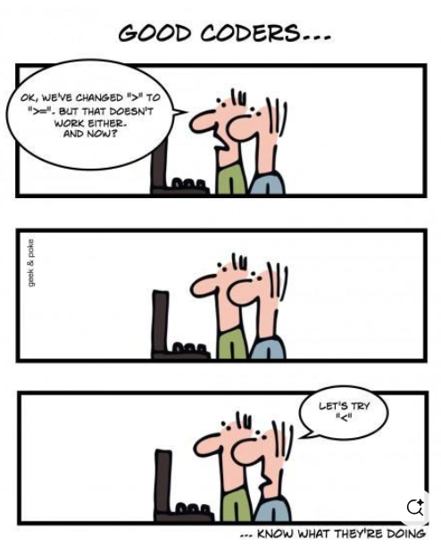
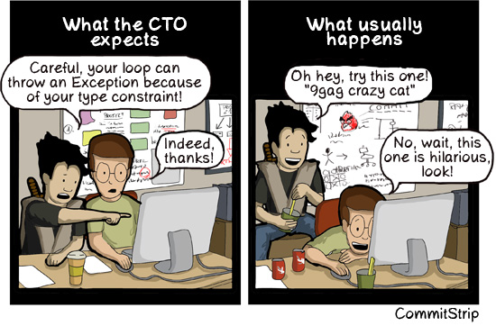
“Pair Programming”
https://www.commitstrip.com/en/2012/08/14/pair-programming/?
© Geek & Poke

Slide 62
Discussion
What are reasons for having programmers working in pairs?
What are reasons they shouldn’t?
Notes:
also, why should they not
personality conflicts
ergonomics
blind leading the blind
improved communication
focused, reinforcing minds
code inspection and peer review
shared code knowledge
improved morale

Slide 63
Pair Programming
Synergies:
More ideas
Complementary skills
Better consideration of alternative solutions
Learning
Expert/student apprenticeship
Continuous critique to learn new things
Notes:
mentorship

Slide 64
Pair Programming
Synergies:
Pressure
They do not want to let each other down, or waste each other’s time
Courage
They give each other confidence to do things they might avoid if alone
Notes:
haunted houses are more scary when you’re alone

Slide 65
Pair Programming
Synergies:
Reviews
Better able to reveal defects with more eyes looking at the code
Debugging
Bugs reveal themselves when one explains the misbehaving code to the other
Notes:
rotating pairs

Slide 66
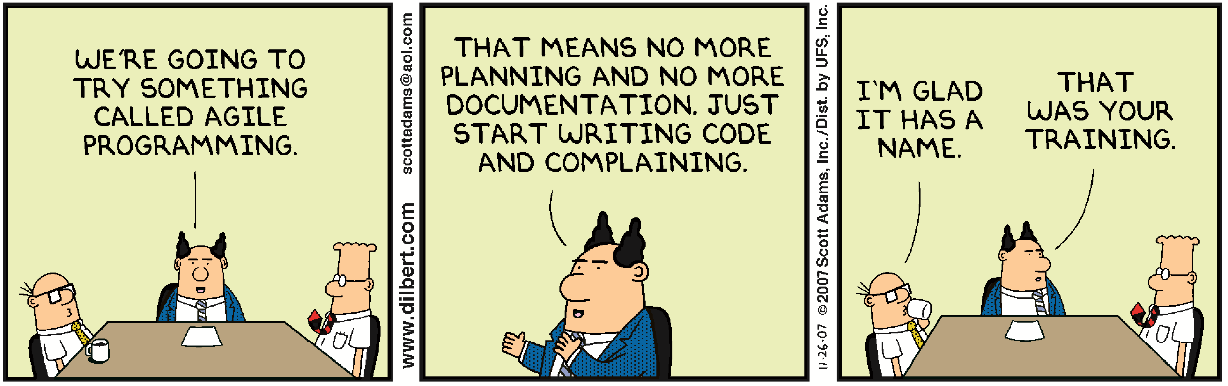
“Agile Programming”
DILBERT © 2003 Scott Adams

Slide 67
Scrum
One part of the Agile development process
Based on:
Feedback, roles, transparency, meetings, prioritization and planning
Like classic engineering management, and is often used onsite in civil engineering and software development

Slide 68
Scrum
Roles:
Scrum master
Acts as a coach, meeting facilitator, and administrator
Knows the process (Agile, XP, etc.)
Protects the team from distractions and helps them follow Scrum
Product owner
Represents the customer
Defines product backlog
Team members
Write code

Slide 69
Scrum
Meetings:
Many per iteration
Daily scrum
Once per iteration
Planning meeting
Review
Retrospective

Slide 70
Scrum
Daily scrum:
AKA daily “standup”
Time limited
Everyone is standing, so they are more uncomfortable and want to finish soon
Each team member answers 3 questions:
What did you do?
What are you going to do?
What is blocking you?

Slide 71
Scrum
Planning meeting:
First meeting of the iteration (only on first day)
Input: requirements and user stories
Output: choose appropriate stories to work on next
Estimate their cost in time
Prioritize them
Fit them into the time left for the iteration
Notes:
The goal of the planning meeting (Sprint Planning?) is to set the stage for work to be done.
- Makes sure everyone understands the goal and how their work contributes to the goal
Planning helps create a rhythm to keep progress steady
Set the agenda and focus of each sprint
Planning meetings make sure that the team knows what needs to be done, which helps increase focus and break down the complex work into smaller tasks
Helps to plan the deliverables for the next meeting
Easy to get stuck on details of the plan
Focus on planning just enough that your team can deliver some output
Don’t get too specific
Allow for safeguards for self-organization

Slide 72
Scrum
Review:
Review work completed
Review work not completed
Adjust and prioritize
Demonstrate current system

Slide 73
Scrum
Retrospective:
Review issues faced with quality and personnel
Try to improve the process
What went well?
What could be improved?
Stay calm

Slide 74
More Information
Articles:
“A Rational Design Process: How and Why to Fake It”
D. L. Parnas and P. C. Clements
IEEE TSE, 12(2), 1986
“Software Development Worldwide: The State of the Practice”
M. Cusumano, A. MacCormack, C. F. Kemerer, and W. Crandall
IEEE Software, November/December 2003
“How Microsoft Builds Software”
M.A. Cusumano and R.W. Selby
Comm. ACM, 4(6), 1997

Slide 75
More Information
Books:
Software Project Survival Guide
S. McConnell
Microsoft Press, 1998
The Build Master
V. Maraia
Addison-Wesley, 2005
Extreme Programming Explained
K. Beck
Addison-Wesley, 2004
Pair Programming Illuminated
L. Williams and R. Kessler
Addison-Wesley, 2002

